Slide 1

AnSaVi Presents – Rock Paper Scissors
https://visheshgargavi.github.io/AnSaVi/
Submitted to –
Saket Sharma
Dharmesh Gurjar
Kartik Udawat
Created By –
Antara Banerjee
Vishesh Garg
Sahil Mishra

Slide 2
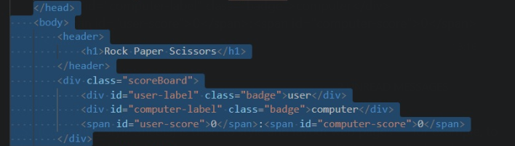
HTML
HTML (HyperText Markup Language) is the code that is used to structure a web page and its content. For example, content could be structured within a set of paragraphs, a list of bulleted points, or using images and data tables.
CODE SNIPPET:

Slide 3
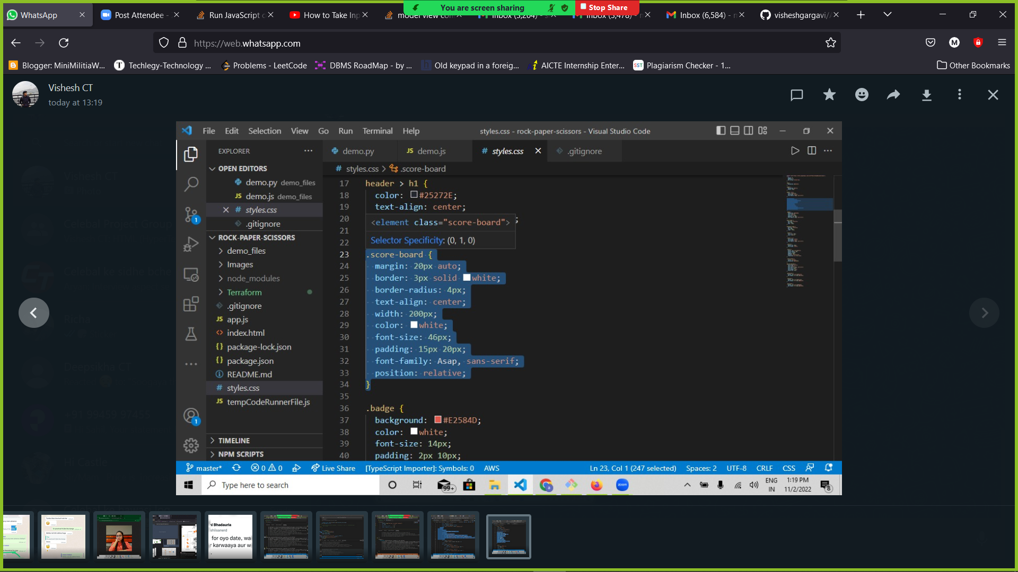
CSS
CSS (Cascading Style Sheets) is used to style and layout web pages — for example, to alter the font, color, size, and spacing of your content, split it into multiple columns, or add animations and other decorative features.
CODE SNIPPET:

Slide 4
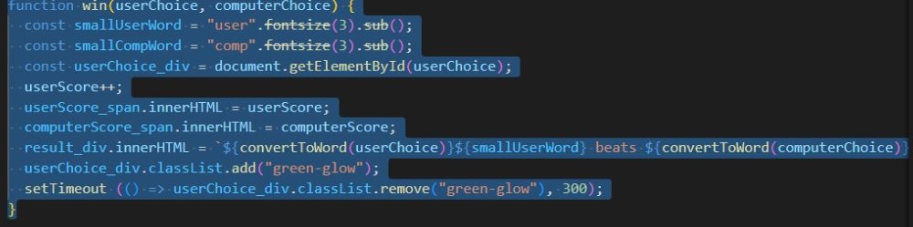
JAVASCRIPT
JS is a Synchronous Single-Threaded Language.
HTML and CSS are languages that give structure and style to web pages, JavaScript gives web pages interactive elements that engage a user with the help of web API’s.
CODE SNIPPET:

Slide 5
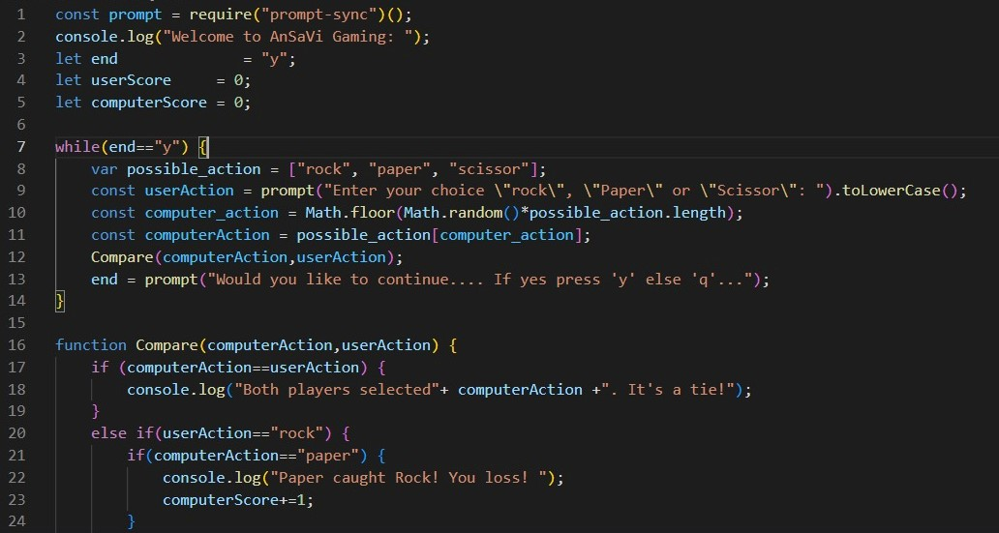
CONSOLE BASED PROGRAM
The JavaScript console is a command line interface in your browser that can execute snippets of code

Slide 6
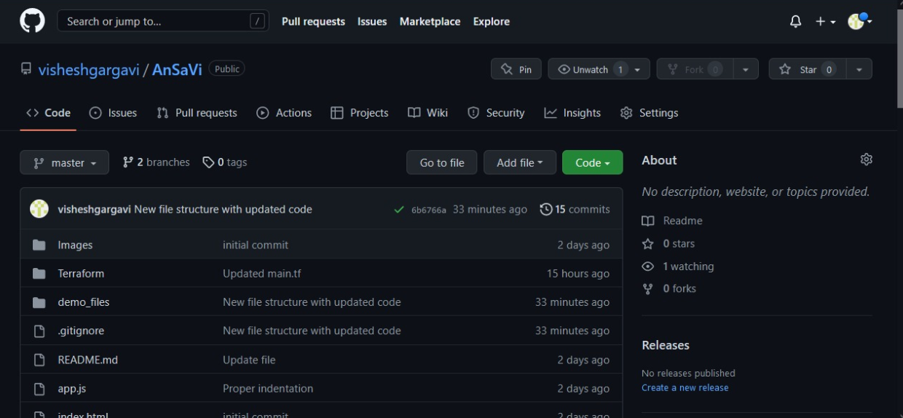
GITHUB
GitHub is a code hosting platform for version control and collaboration
Some of the git commands:
git add
git commit -m “Your Message”
git push -u origin master
git merge to_branch from_branch
git cherry-pick commit-id

Slide 7
Thanks!

